Slide 2
Lecture 29 DISCRETE STRUCTURE
SARA SHAFIQUE

Slide 3


The Binomial Distribution
"Bi" means "two" (like a bicycle has two wheels), so this is about things with two results.

Slide 4

How to tell if an experiment is binomial?
Try to answer the following 4 questions
Is there a fixed number of trials?
Answer should be yes for all questions
Example:
Telephone surveying a group of 200 people to ask if they voted?
Yes
2) Counting the average number of dogs seen daily on street.
No

Slide 5
How to tell if an experiment is binomial?
Try to answer the following 4 questions
2) Are there only 2 possible outcomes?
Answer should be yes for all question
Example:
1) Telephone surveying a group of 200 people to ask if they voted?
Yes
2) We take a survey of 50 traffic lights recoding whether the light was red, green, or yellow at that time.
No

Slide 6
How to tell if an experiment is binomial?
Try to answer the following 4 questions
3) Are the outcomes independent of each other?
Answer should be yes for all question
Example:
1) Telephone surveying a group of 200 people to ask if they voted?
Yes
2) You are at a fair, playing “pop the balloons” with 6 darts, There are 20 balloons. 10 of the balloons have ticket inside that says “win”, and 10 have a ticket that says “lose”.
No

Slide 7
How to tell if an experiment is binomial?
Try to answer the following 4 questions
4) Does the probability of success remain the same for each trial?
Answer should be yes for all question
Example:
Telephone surveying a group of 200 people to ask if they voted?
Yes

Slide 8

General formula for Binomial Distribution

Slide 9
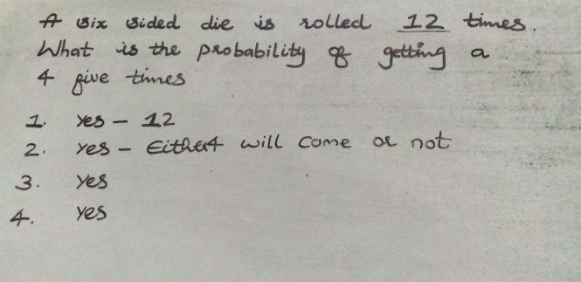
Binomial Distribution Example

Slide 10
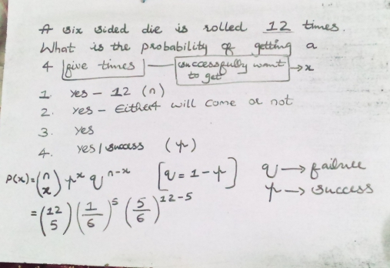
Binomial Distribution Example

Slide 11
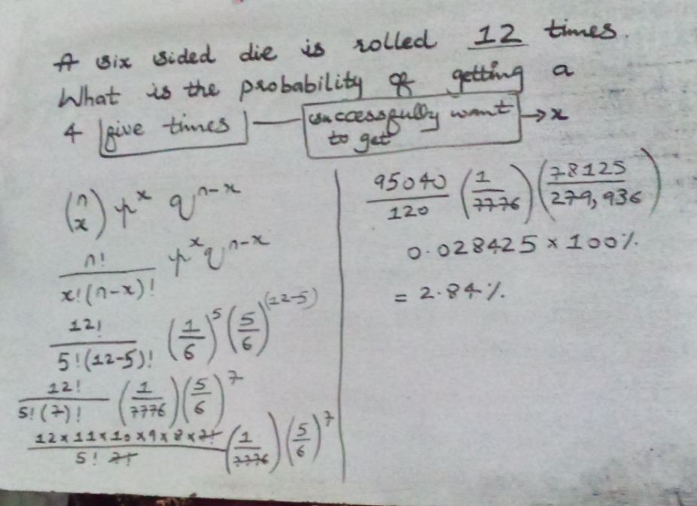
Binomial Distribution Example

Slide 12
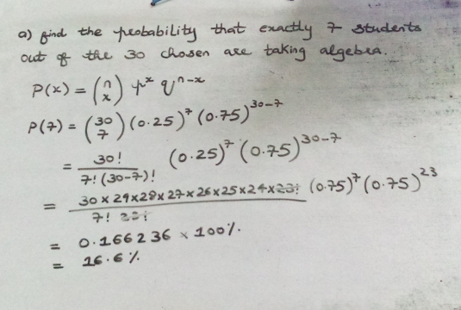
Binomial Distribution Example

Slide 13
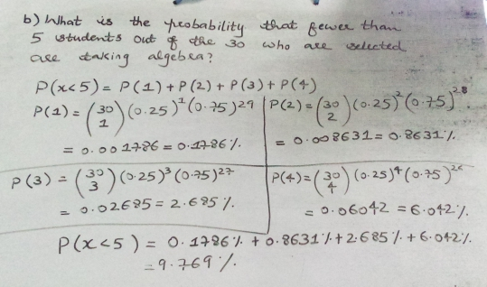
Binomial Distribution Example

Slide 14
Mean
The mean (average) of a data set is found by adding all numbers in the data set and then dividing by the number of values in the set.

Slide 15
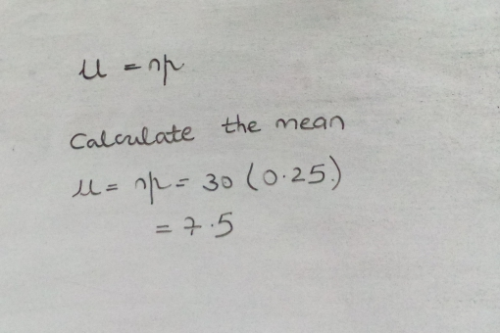
Mean of Binomial Distribution Example

Slide 16
Standard Deviation
A quantity expressing by how much the members of a group differ from the mean value for the group

Slide 17
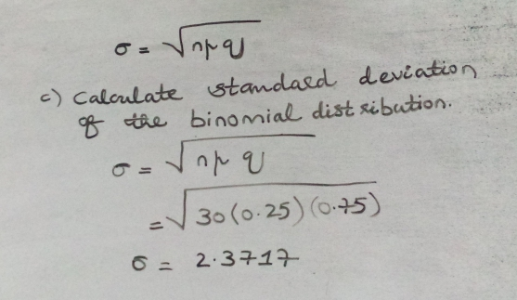
Standard Deviation of Binomial Distribution Example

Slide 18
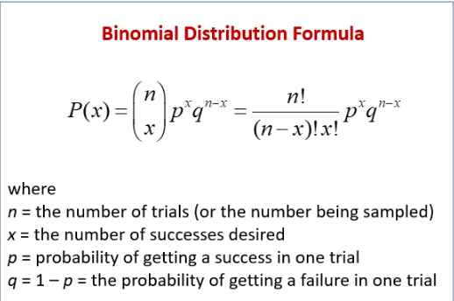


Slide 19
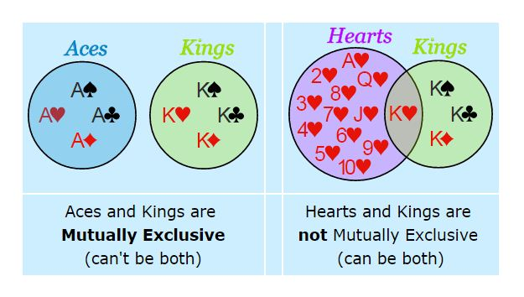

Slide 20
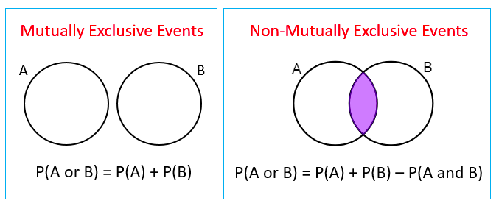
Mutually Exclusive Events and Non Mutually Exclusive Events

Slide 21

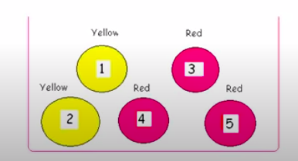
Mutually Exclusive Events

Slide 22
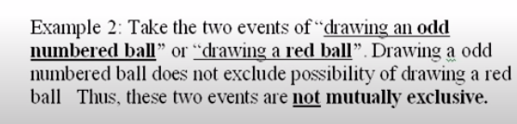
Non Mutually Exclusive Events

Slide 23
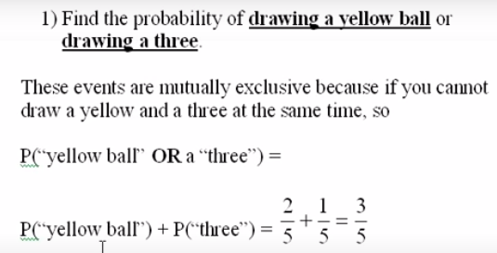

Slide 24
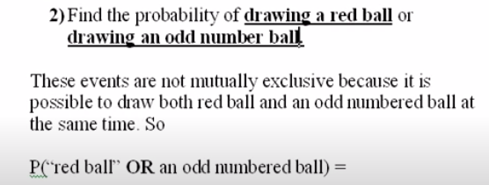
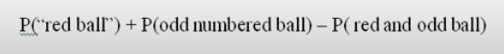
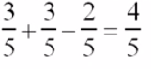

Slide 25
Rules of Probability - "OR" or Unions
Mutually Exclusive Events
Two events are mutually exclusive or disjoint if they cannot occur at the same time.
If two events are disjoint, then the probability of them both occurring at the same time is 0.
Disjoint: P(A and B) = 0

Slide 26
Rules of Probability - "OR" or Unions
Mutually Exclusive Events
Specific Addition Rule
Only valid when the events are mutually exclusive.
P(A or B) = P(A) + P(B)

Slide 27
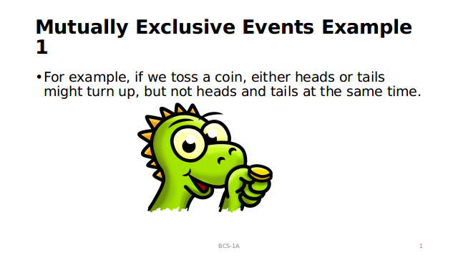

Slide 28
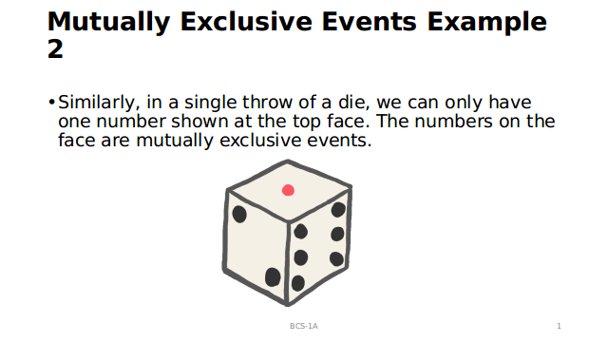

Slide 29
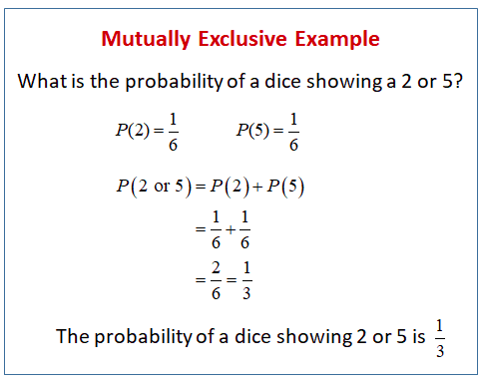

Slide 30
Rules of Probability - "OR" or Unions (Example)
Non-Mutually Exclusive Events
General Addition Rule
P(A or B) = P(A) + P(B) - P(A and B)

Slide 31
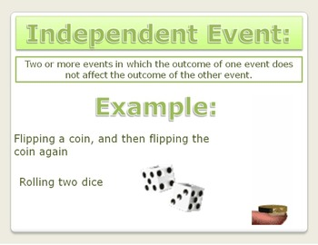

Slide 32
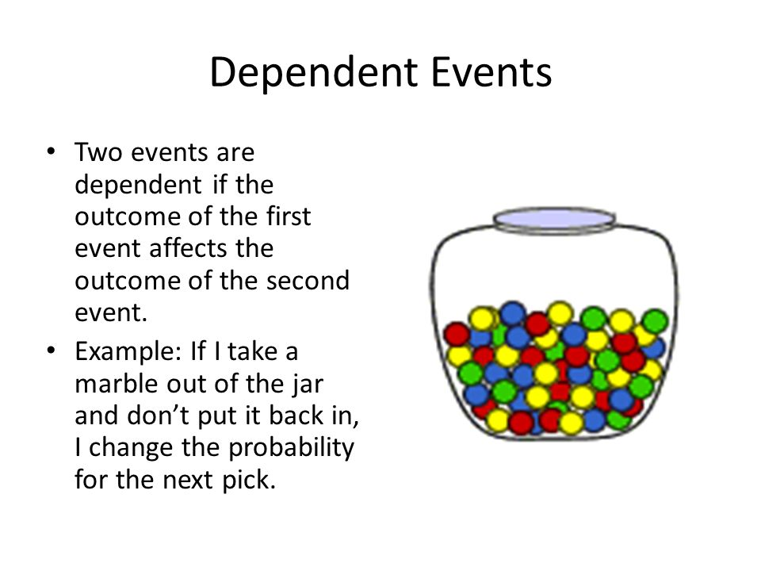

Slide 33
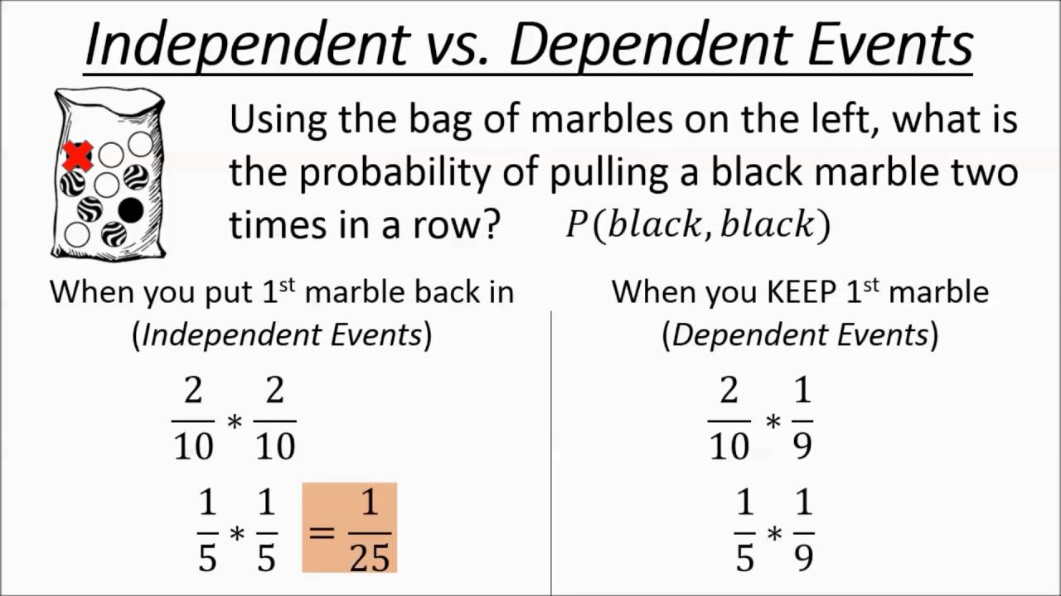

Slide 34
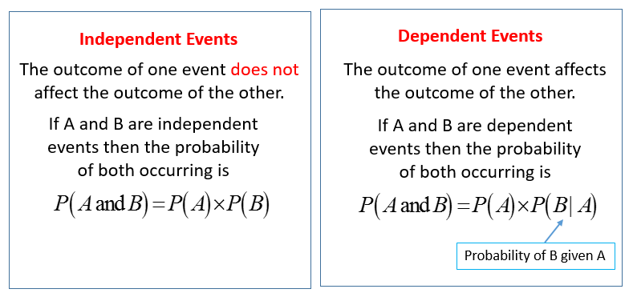

Slide 35
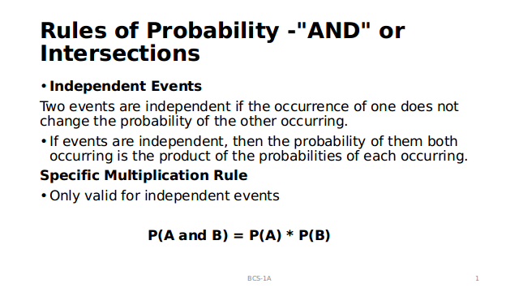

Slide 36
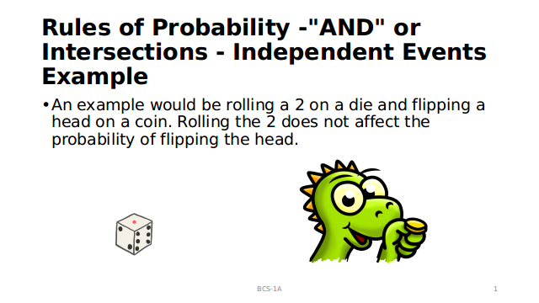

Slide 37
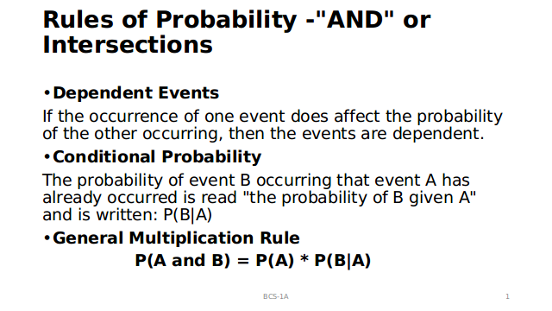

Slide 38
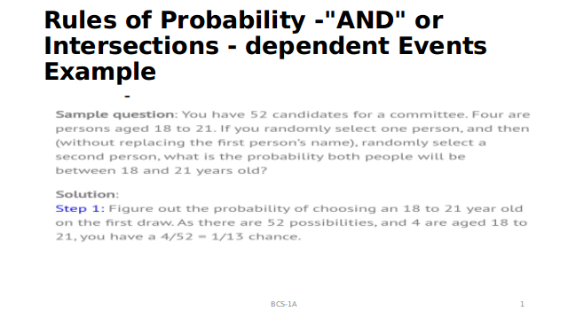

Slide 40
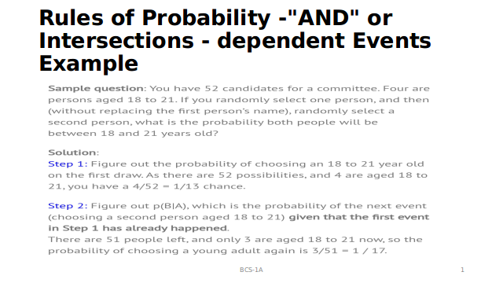

Slide 41
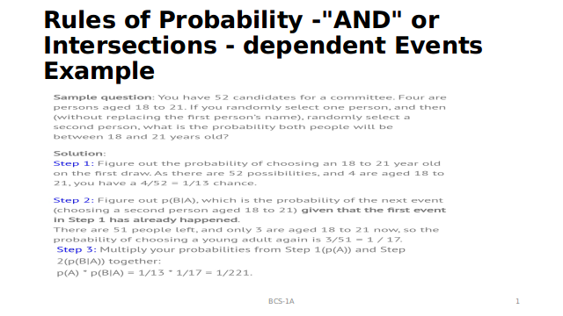

Slide 42
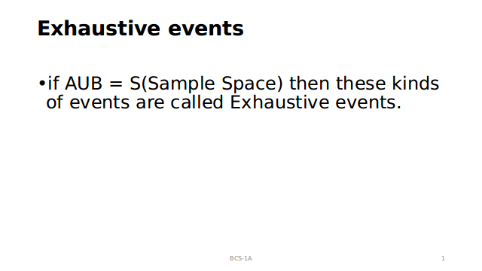

Slide 43
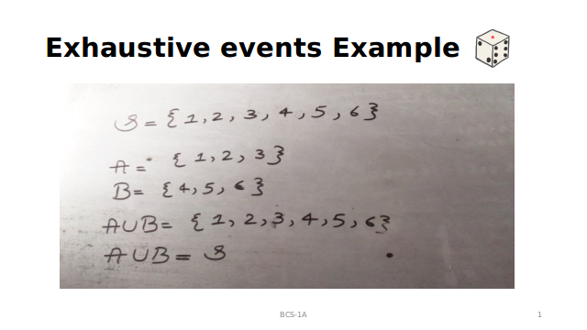

Slide 44
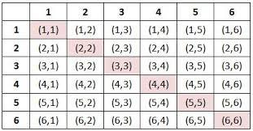
Sampling : Probability for Rolling Two Dice
When two dice are thrown simultaneously, thus number of event can be 36 because each die has 1 to 6 number on its faces. Then the possible outcomes are shown in the below table.
Probability – Sample space for two dice (outcomes):

Slide 45
Probability for Rolling Two Dice
Note:
(i) The outcomes (1, 1), (2, 2), (3, 3), (4, 4), (5, 5) and (6, 6) are called doublets.
(ii) The pair (1, 2) and (2, 1) are different outcomes.

Slide 46
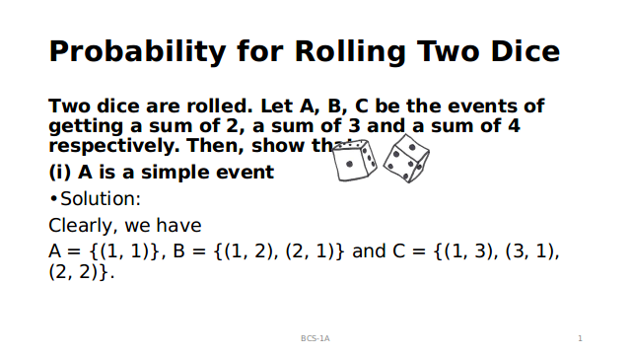

Slide 49
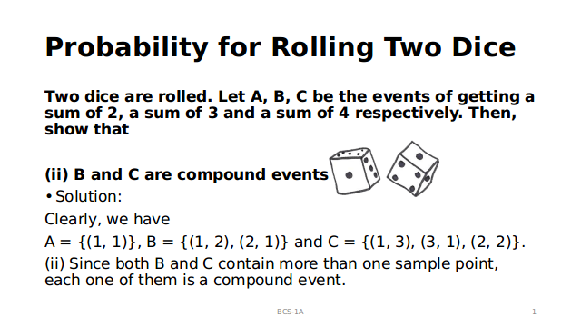

Slide 50
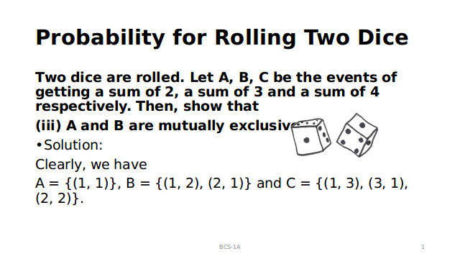

Slide 51
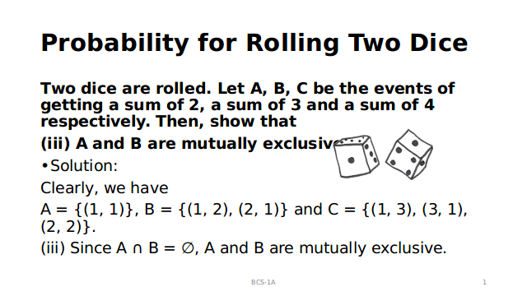

Slide 52
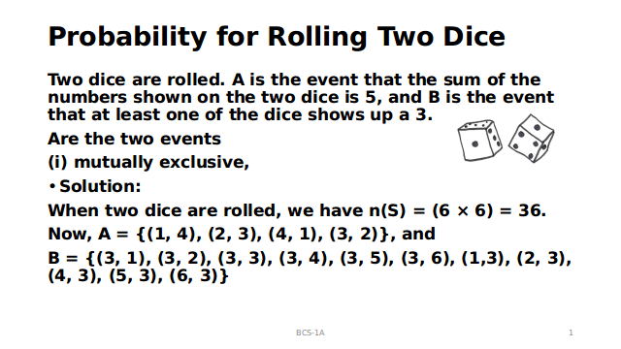

Slide 53
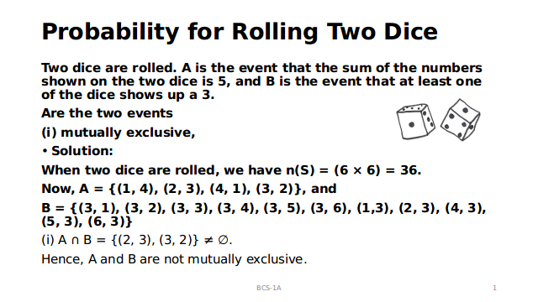

Slide 54
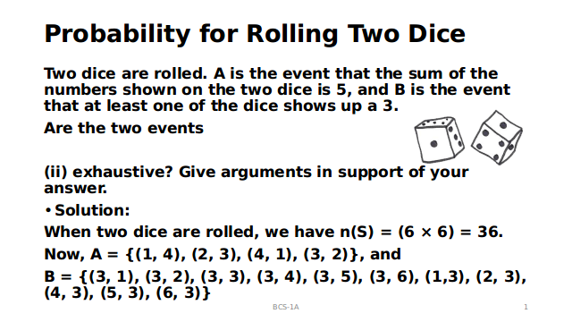

Slide 55
